Slide 1

Narrative Techniques

Slide 2
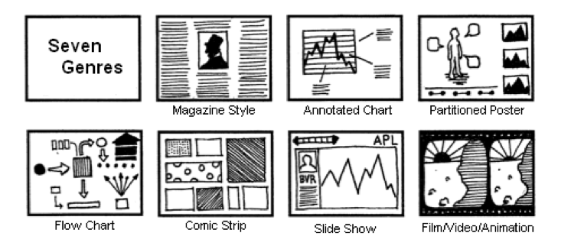
Segel & Heer, 2010

Slide 3
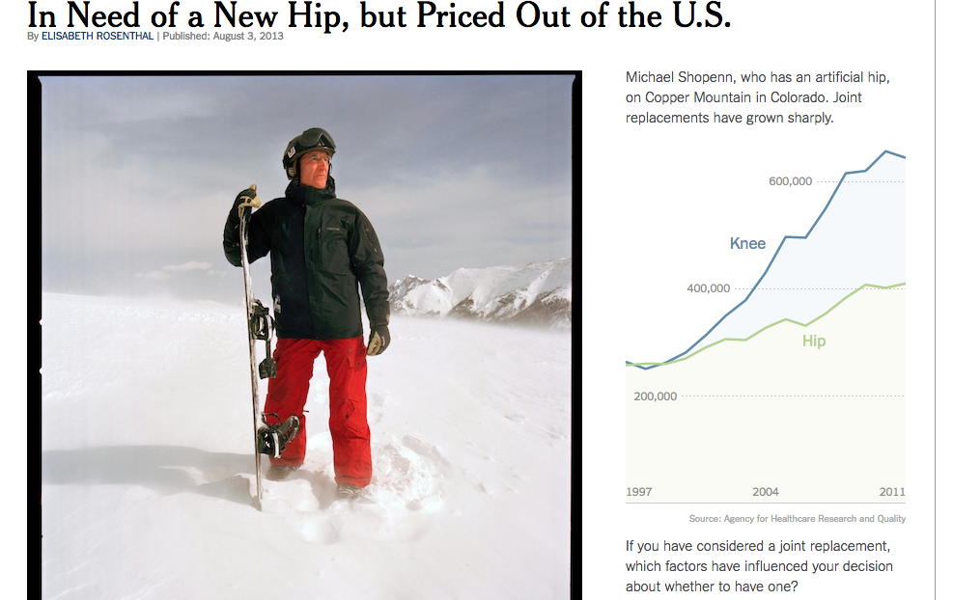
Magazine Style
http://www.nytimes.com/2013/08/04/health/for-medical-tourists-simple-math.html
Notes:
Image embedded in a page of text.

Slide 4
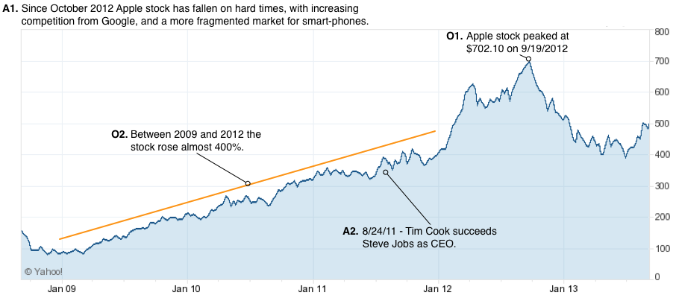
Annotated Chart
Notes:
http://towcenter.org/storytelling-with-data-visualization-context-is-king/

Slide 5
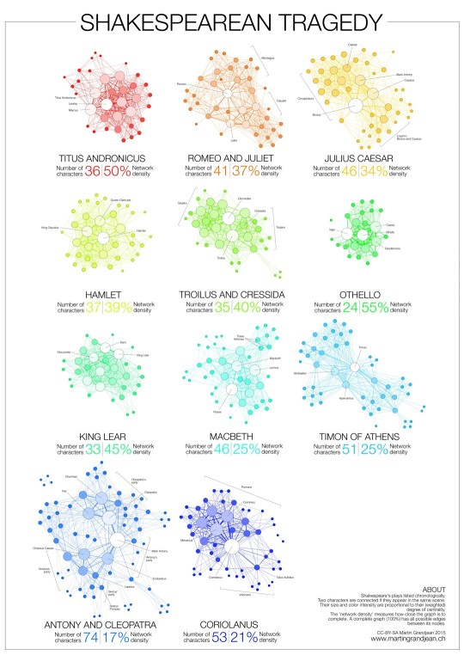
Partitioned Poster
Notes:
http://ebookfriendly.com/best-book-visualizations/

Slide 6
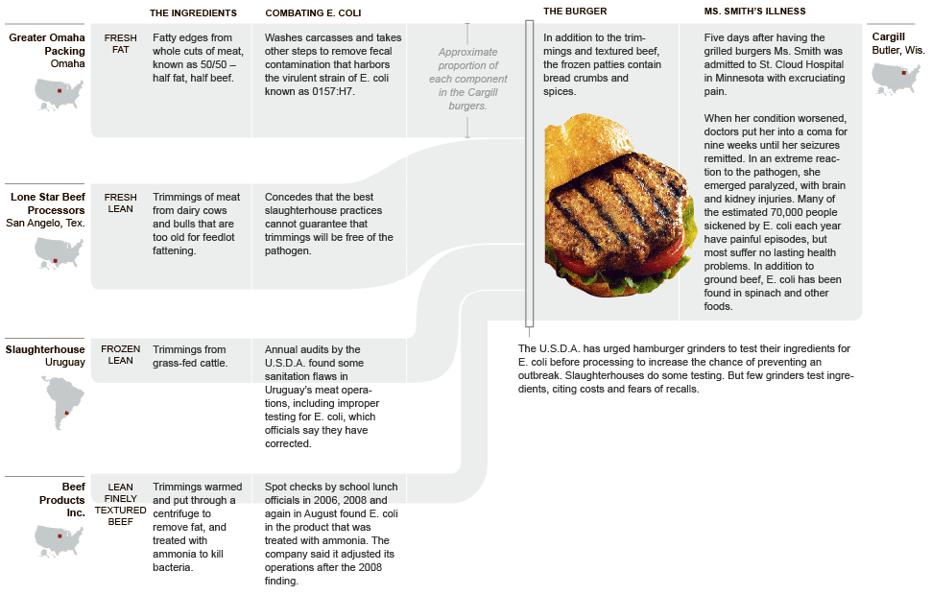
Flow Chart
https://static01.nyt.com/packages/flash/newsgraphics/2009/1004-meat/20091004-meat.gif

Slide 7

Comic Strip
https://ww2.kqed.org/lowdown/2015/09/28/searching-for-safety-europes-refugee-crisis-explained-comic-infographic/

Slide 8
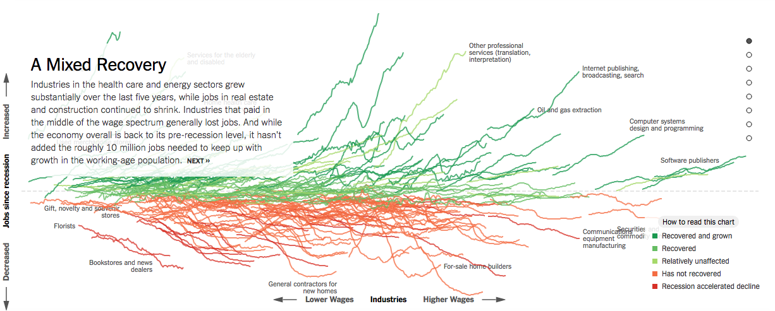
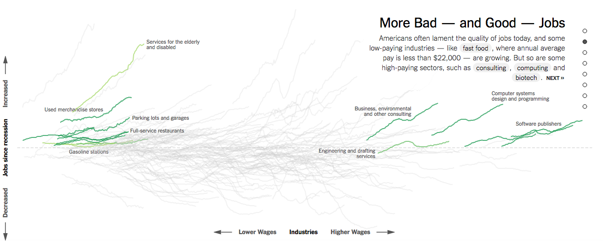
Slide Show
https://www.nytimes.com/interactive/2014/06/05/upshot/how-the-recession-reshaped-the-economy
-in-255-charts.html

Slide 9
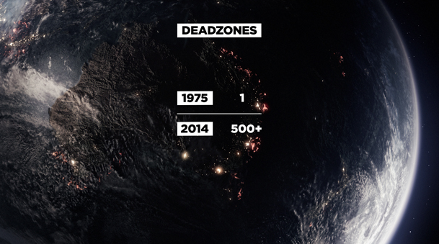
Film/Video/Animation
http://filmmakermagazine.com/87983-charting-the-course-data-visualization-in-documentary-film/

Slide 10
Slide show + annotated chart + ?
Notes:
Mix and match the genres as needed.

Slide 11
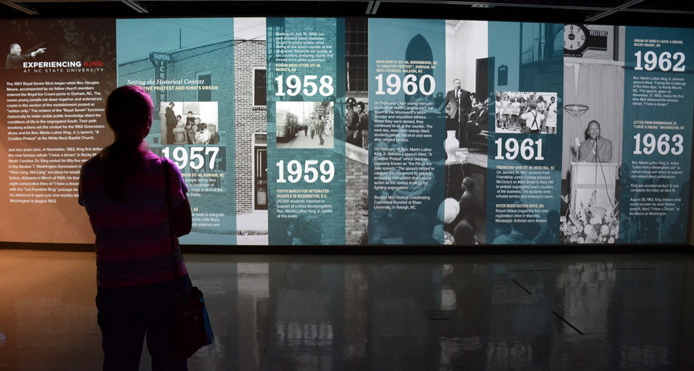
Visual structuring: communicates the structure of the narrative
Notes:
communicates the structure of the narrative and a viewer’s place within that structure

Slide 12
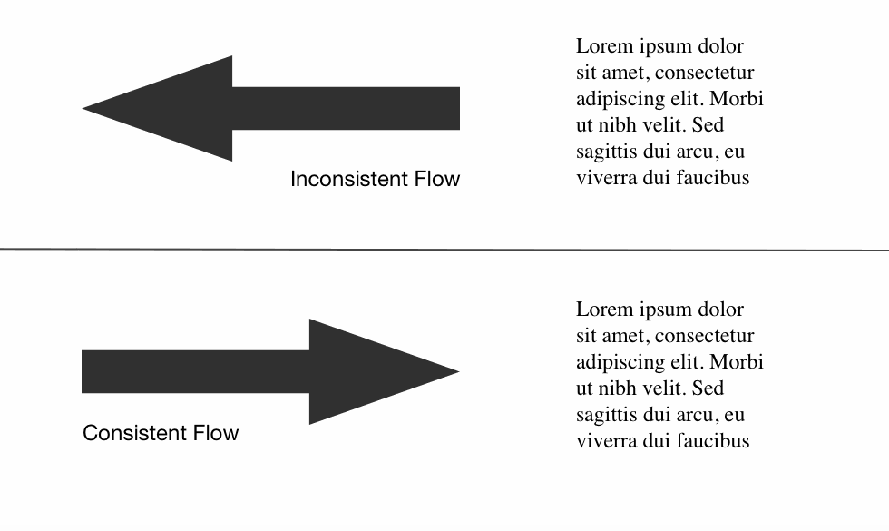
Flow: Have the path the eye follows to align with the intended views/ interactions
Notes:
PLACEHOLDER IMAGE. https://www.smashingmagazine.com/2015/04/design-principles-compositional-flow-and-rhythm/
Draw on several commonly used graphic design principles compositional flow

Slide 13

Focal points and hierarchy: Give the most important elements a ranking of perceptual focus
Notes:
PLACEHOLDER IMAGE. Draw on several commonly used graphic design principles
https://www.smashingmagazine.com/wp-content/uploads/2015/02/focal-points-large-preview-opt.png

Slide 14
Grids
Notes:
Alberto Cairo says to divide into rectangles of different sizes
He leaves out alignment, but it's there
Similar to idea of grids-based design

Slide 15
Highlighting: color, motion, framing, size, audio to direct attention to particular data
Data characters?
Notes:
Who are the data characters, organizations, events, people, patterns that are active in the story?

Slide 16
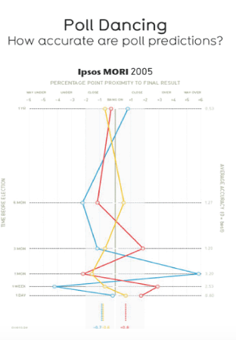
Visual metaphor
Image Source: http://faculty.washington.edu/jhullman/vis_rhetoric.pdf

Slide 17

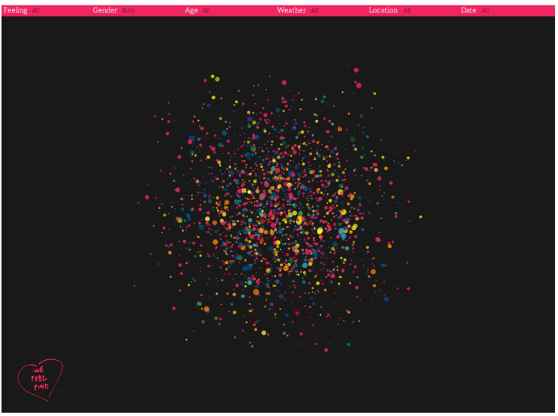
Give data a face and context
WeFeelFine.org
Notes:
ca.edu/~rbegenhoefer/InfoViz/readings/wefeelfine.pdf

Slide 18
Transition guidance:
Help movement between scenes

Slide 19
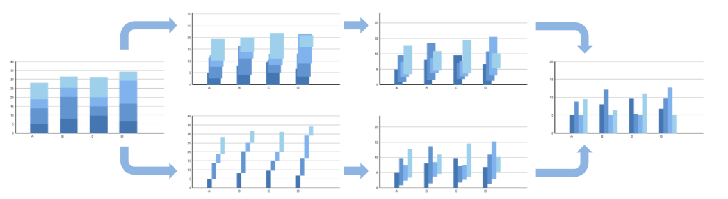
Animation
Timing and Staging
Diagram source: Heer, J., & Robertson, G. (2007). Animated transitions in statistical data graphics. IEEE Transactions on Visualization and Computer Graphics, 13(6), 1240-1247.
Notes:
Breaking down staged transitions

Slide 20
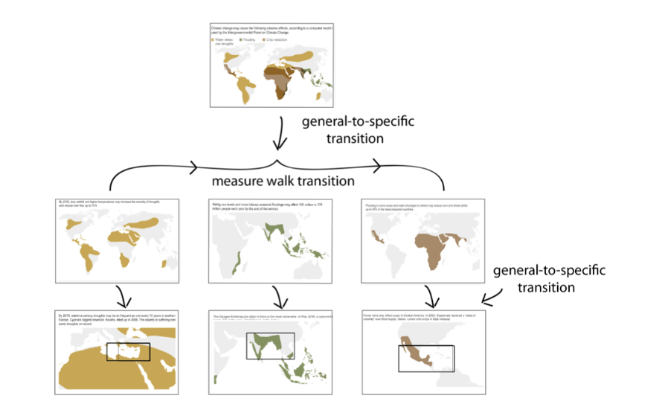
Transitions
Diagram Source: Hullman, J., Drucker, S., Riche, N. H., Lee, B., Fisher, D., & Adar, E. (2013). A deeper understanding of sequence in narrative visualization. IEEE Transactions on Visualization and Computer Graphics, 19(12), 2406-2415.
Notes:
https://www.microsoft.com/en-us/research/wp-content/uploads/2016/02/hullman.pdf

Slide 21
Remember to Use
Ordering/focus
Messaging
Interactivity
Notes:
Ordering both within the page and as the user moves through slides etc. What are the interactive features, what

Slide 22

Martini Glass Structure

Slide 23

Interactive Slide Show

Slide 24

Drill-Down Story

Slide 25

Collaborative Narratives
Notes:
With collaborative tagging etc.

Slide 26
Workflow
1. Settle on a story
2. Do research
3. Find visual analogies, make sketches
4. Flesh out the layout, graphic forms
5. Polish the details (words, icons)
Notes:
This is explanatory vis, you need to know the story.
Cairo: "define the focus"
Do research could be interviews, data gathering (start sketching)
Important to sketch early, play, iterate
Create layout from sketches
Polish the details only at the end

Slide 27
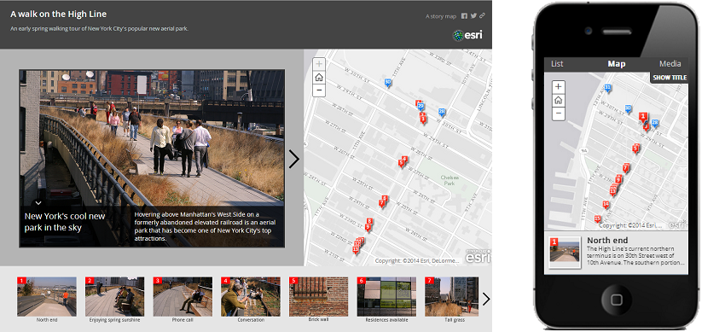
Template vs. Custom?
https://github.com/Esri/map-tour-storytelling-template-js
Notes:
Don’t just take the template path of least resistance.

Slide 28
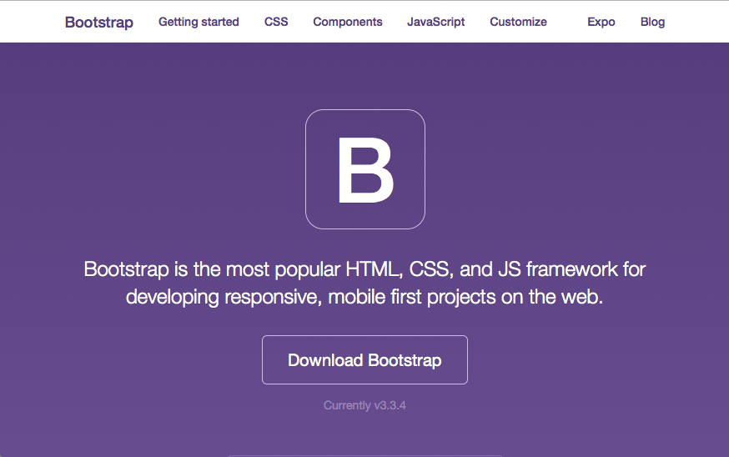
Getbootstrap.com
Notes:
Bootstrap – most popular responsive web dev library
Define columns, fixed or responsive

Slide 29
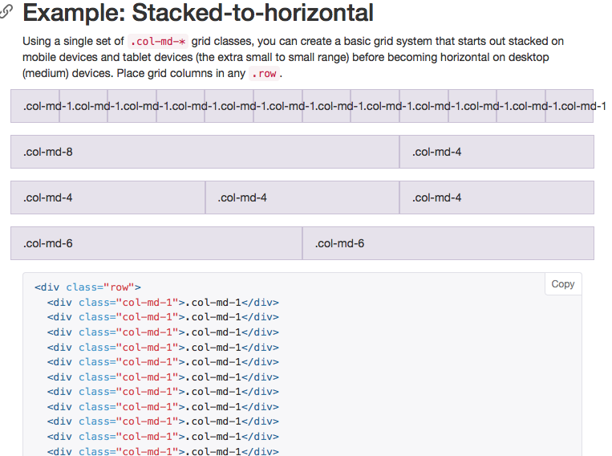
Notes:
Bootstrap – most popular responsive web dev library
Define columns, fixed or responsive

Slide 30
Story Evaluation
Interviews (5 +/– participants)
Surveys on affect/emotion
Engagement across pages/content
Analysis of annotations or comments
Crowdsourcing data collection
Notes:
How do you evaluate an effective story? The evaluation methods so far have largely focused on task not enjoyment. Might decide to re-order content or vis slides to go from a drill down to a build up. Other outcomes – does it drive responses, uptick in calls, etc.

Slide 31
Tools
Tableau stories
Story maps
https://storymaps.arcgis.com/en/
Notes:
Add as web link

Slide 32


